Slide 1
Abstract Thinking in Infancy
Rocio Bautista
Dr. Susan Hespos
Infant Cognition Lab
Notes:
Humans are unique in their ability to think abstractly (e.g. using language, learning relations). Previous work from our lab has shown that infants can learn simple abstract relations, like whether two objects are the “same” or “different”. In this study, we investigated flexibility in early learning. Our question was whether repetition or comparison is more important. Multiple exemplars allow for comparison, and previous research has shown that infants who see two to four exemplars can generalize the relation to completely novel exemplars. In this experiment, we explored the role of repetition with only a single example. First, infants saw a single pair of objects that were either the “same” or “different” during the learning portion of the experiment. Then, in test trials, all infants saw an alternation between same and different pairs. Their looking duration was a measure of their relational learning. Surprisingly, 3-month olds learned the relation, but 7- and 9-month olds did not. We interpret these findings as revealing that encoding ability changes over development. The youngest infants are not consistent at encoding the objects, most likely because they encoded one part of each object during each trial, actually believing it to be different objects, and consequently learned the relational characteristics between the objects. Seven- and nine-month olds are much better encoders, and dismissed the repetition of the single exemplar. Showing them one exemplar did not help them learn.

Slide 2
Research Question
Is repetition or comparison more important for abstract learning in infants?
Investigating flexibility in early learning
“Same” and “different” is the most basic abstract relation
Previous research showed infants did not learn with 6-exemplars
However, infants do learn when presented with 2 exemplars
Our question is, will infants learn with one exemplar

Slide 3
Research Methodology: Looking-time experiment
Same Condition
Different Condition
Pair Habituation:
Single pair repeated over 6-9 trials
Test Trials

Slide 4
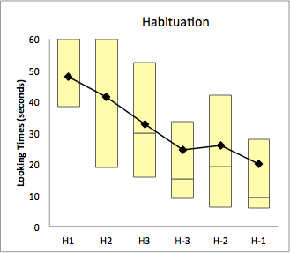
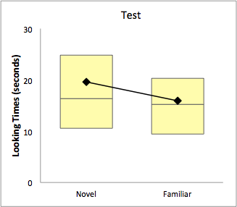
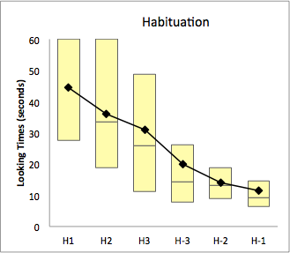
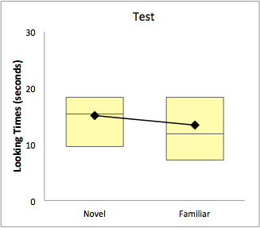
Results
3-month-old infants
7-9-month-old infants

Slide 5
Conclusions
Encoding ability changes over development
3-month-olds are inconsistent encoders
7- to 9-month-olds are better at encoding
Learning patterns change between 3 and 7 months

Slide 6
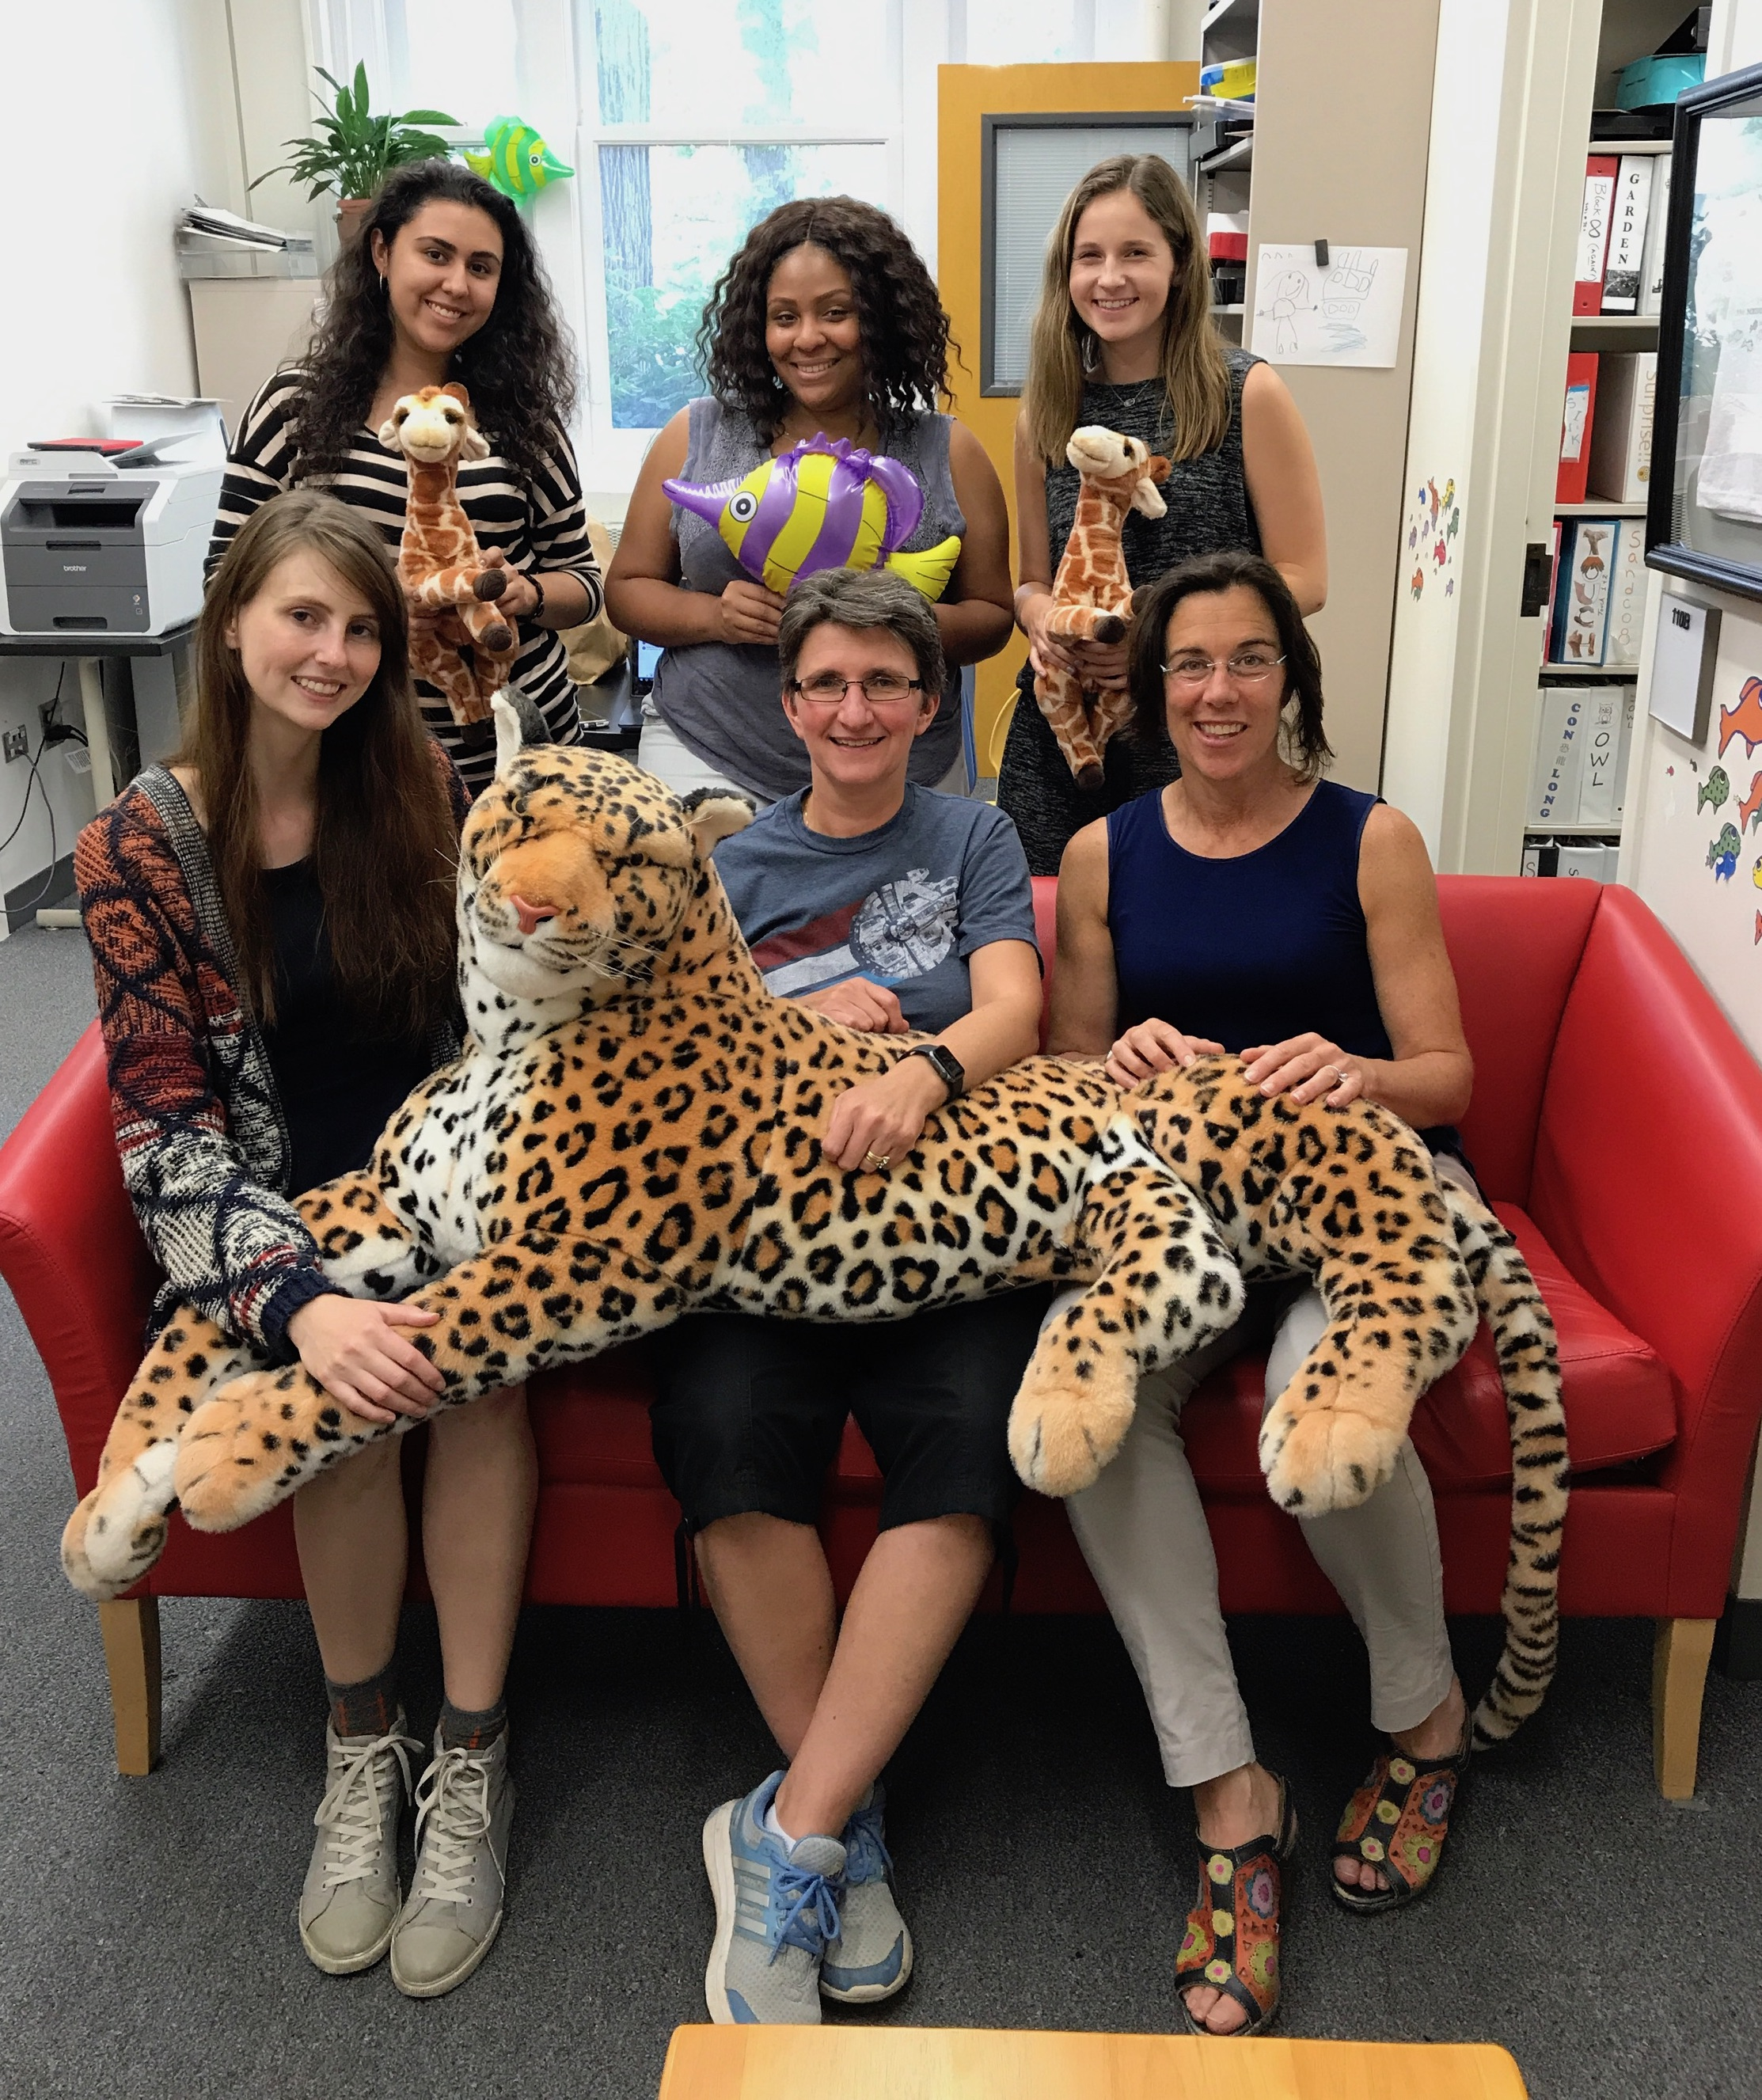
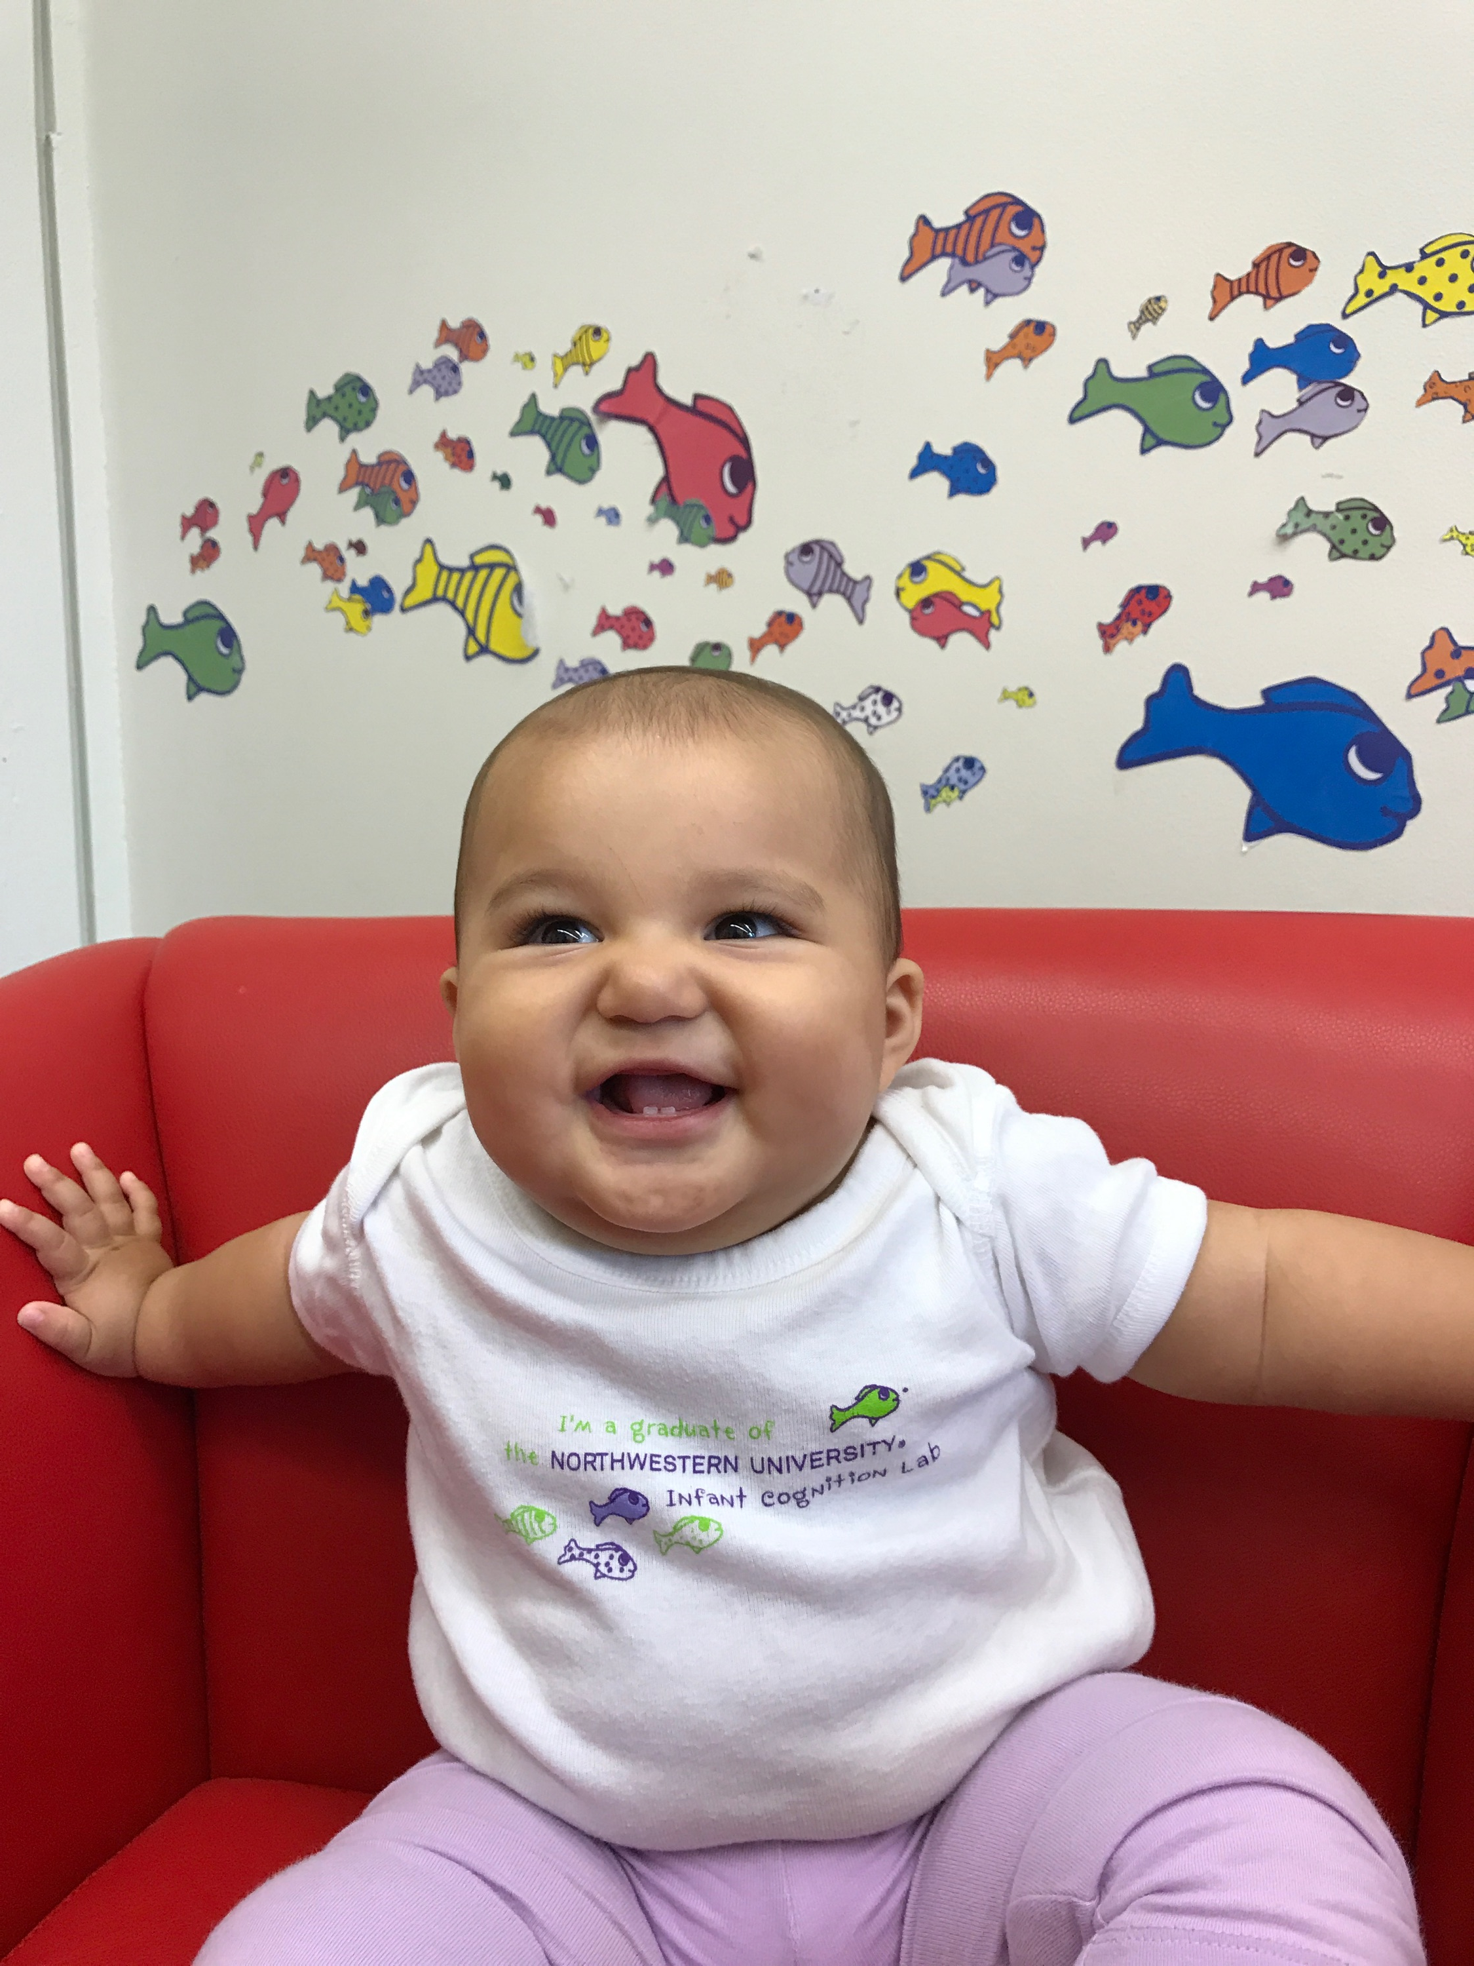
Acknowledgements
Thank you to:
Dr. Sue Hespos for having me in her lab and for her valued mentorship this summer.
Dr. Jaime Dominguez, Dr. Shelby Hatch, Dean Mary Finn, and Ms. Cindy Pingry for coordinating this program and providing support for all of us.
Brian Posner for funding this program to enhance undergrad research experience.
All of the members of the Infant Cognition Lab.
All the parents who agreed to have their infants participate in the research.
Any questions?

