Slide 1
The History and Future of Titanium Production
Aldo Montes
Professor Berns
Posner Fellowship Program

Slide 2
Titanium overview
Advantages
Disadvantages
Highest strength-to-density ratio of common metals
High melting point (1675℃) improves heat resistance of alloys
Exterior oxide formation resists corrosion
Incredibly expensive to produce
Requires high temperatures to refine (up to 1000℃)
Currently requires creation of intermediate TiCl₄ from the ore for proper refinement
Titanium is highly reactive with atmospheric gases, processing needs inert atmosphere

Slide 3
Hunter Process
TiCl₄(g)
React w/ Sodium
4Na(l)+TiCl₄(g)
Ti(s)
1910- Matthew Hunter produced the first batch of pure titanium
Depended on
Airtight Steel bombs- used for production of other metals
Vacuum technology to remove air

Slide 4
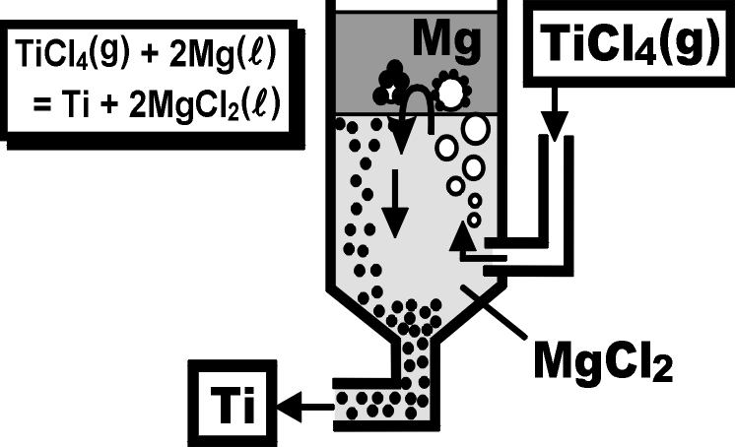
Kroll Process
1937- William J. Kroll modified Hunter Process
Most used process for titanium production
Depended on
Commercialization of Argon in the 1930s
Von Bolton Arc Furnace modified from use in Tantalum

Slide 5
The FFC Cambridge Process
Electrochemical process
Most potential for future titanium production
Can use natural TiO₂ instead of TiCl₄
Less energy than Kroll
Inspired by aluminum’s Hall-Heroult Process
Carbon rod used as anode
Uses the metal’s oxide form

Slide 6
FAST-Forge
Newest titanium process (developed in 2016)
Uses leftover powder from other processes
Depended on
Field Assisted Sintering Technique, developed for consolidating granular material (developed in 2002)

Slide 7
Proposed Idea: Adapted Bayer Process
Ilmenite (FeTiO₃)
Roasted w/ NaOH at 850℃
Leached w/ Water (H₂O)
2NaOH + TiO(OH)₂
Calcined
TiO₂
Na_{x}Fe_{x}Ti_{x}O_{x} (most importantly, Na₂TiO₃)
Extraction process for Al₂O₃
React aluminum ore w/ NaOH
Leach w/ Water
Calcine (heated to high temp in air)
Experiment Treated Ilmenite (FeTiO₃) with NaOH
80% TiO₂ recovered
Perfect source for FFC Cambridge process

Slide 8
Conclusion
Titanium Production innovation historically relies on unrelated technological developments
A more chemically-direct extraction process avoiding TiCl₄ can make titanium more affordable
Key to cheaper titanium production may lie in Aluminum’s Bayer Process

Slide 9
Bibliography
“It’s Elemental - The Element Titanium.” Accessed July 9, 2018. https://education.jlab.org/itselemental/ele022.html
“Steel | Metallurgy | Britannica.Com.” Accessed July 16, 2018. https://www.britannica.com/technology/steel.
Gerdemann, S. J. Advanced Materials & Processes. July 1, 2001, pp 42.
Seagle, S. R. Titanium processing https://www.britannica.com/technology/titanium-processing#ref81533 (accessed Aug 2, 2018).
DENNIS, W. H. METALLURGY: 1863-1963; ROUTLEDGE: S.l., 2017.
Sibum, H.; Güther, V.; Roidl, O.; Habashi, F.; Wolf, H. U. Ullmanns Encyclopedia of Industrial Chemistry2017
Hunter, M. A. Journal of the American Chemical Society1910, 32(3).
Froes, F. H. Titanium: Physical Metallurgy, Processing, and Applications; ASM International, 2015.
Argon - Element information, properties and uses | Periodic Table http://www.rsc.org/periodic-table/element/18/argon (accessed Aug 3, 2018).
Almqvist, E. History of Industrial Gases; Springer Science: New York, 2013.
Chen, George Zheng, Derek J. Fray, and Tom W. Farthing. “Direct Electrochemical Reduction of Titanium Dioxide to Titanium in Molten Calcium Chloride.” Nature 407 (September 21, 2000): 361.
Titanium tetrachloride https://pubchem.ncbi.nlm.nih.gov/compound/titanium_tetrachloride (accessed Aug 9, 2018).
Chen, George. (2014). (Free Access) The FFC Cambridge Process and its relevance to valorisation of ilmenite and titanium-rich slag. Mineral Processing and Extractive Metallurgy IMM Transactions section C. 10.1179/1743285514Y.0000000073.
Weston, N.S., and M. Jackson. “FAST-Forge − A New Cost-Effective Hybrid Processing Route for Consolidating Titanium Powder into near Net Shape Forged Components.” Journal of Materials Processing Technology 243 (May 1, 2017): 335–46. https://doi.org/10.1016/j.jmatprotec.2016.12.013.
U Kessel, Heinz & Hennicke, Juergen & Schmidt, Jürgen & Weissgaerber, Thomas & Kieback, Bernd & Herrmann, M & Räthel, Jan. (2006). "FAST" field assisted sintering technology-a new process for the production of metallic and ceramic sintering materials (engl. transl.). Pulvermetallurgie in Wissenschaft und Praxis; Proc. Hagener Symposium (Engl. transl.). 22. 201-37.
Britannica, T. E. of E. Alumina https://www.britannica.com/science/alumina (accessed Aug 9, 2018).
Manhique, A. J.; Focke, W. W.; Madivate, C. Hydrometallurgy2011, 109(3-4), 230–236.

Slide 10
Acknowledgements
Professor Berns
Dr. Pingry
Dr. Hatch
Dr. Dominguez
Brian Posner
Dean Finn

