Slide 1
The Origins of Race-Conscious Affirmative Action
Evidence from the University of Chicago and the University of Wisconsin
Jade Davis
Prof. Anthony Chen
Posner Fellowship Program 2017

Slide 2
Road map

Slide 3
Research Question
My Procedure
My Findings
Discussion

Slide 4
Research question

Slide 5
When and why did American universities adopt race-conscious affirmative action programs?

Slide 6
Previous ideas
Began in later 1960s
Result of unrest
New ideas and evidence
Began in earlier 1960s
Result of moral shift in administration

Slide 7
My procedure

Slide 8
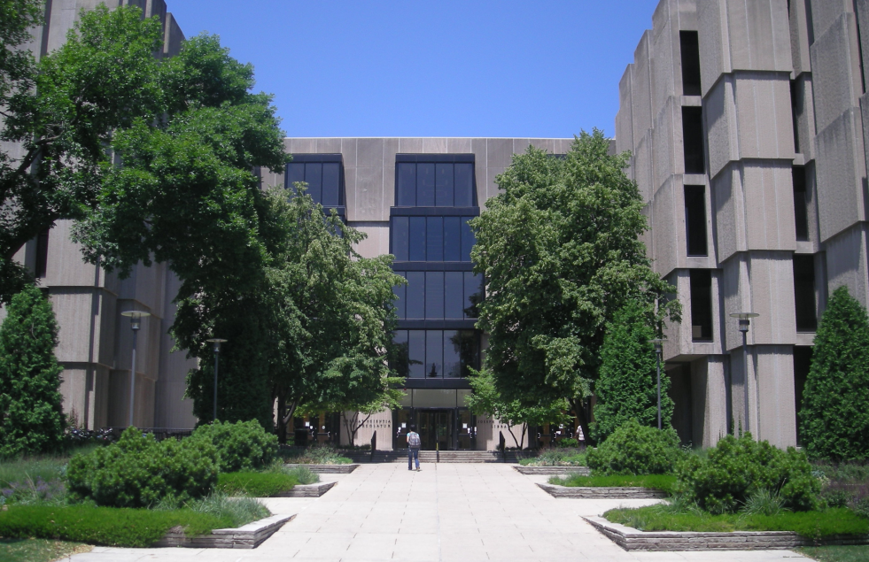
Special Collections at the University of Chicago
Photo: https://commons.wikimedia.org/wiki/File:University_of_Chicago_July_2013_23_(Joseph_Regenstein_Library).jpg

Slide 9
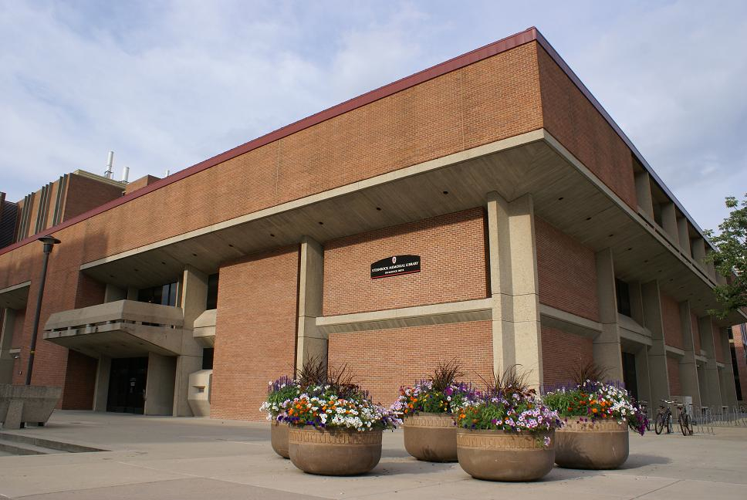
Archives at the University of Wisconsin, Madison
Photo: https://writing.wisc.edu/blog/?p=6251

Slide 10
My findings

Slide 11
Corroborative Evidence

Slide 12
Document: Folder 5, Box 25, Beadle collection, UCSC

Slide 13
New Evidence

Slide 14
Document: Folder 4, Box 321, Beadle collection, UCSC

Slide 15
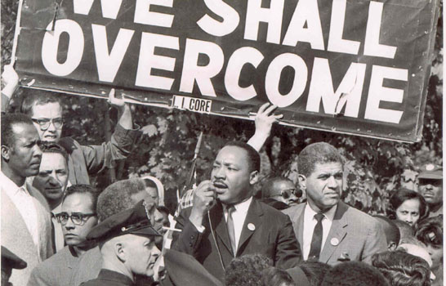
Photo: http://feministing.com/2017/01/16/happy-mlk-day-five-facts-to-refute-the-sanitization-of-martin-luther-kings-legacy/

Slide 16
discussion

Slide 17
My original objectives
My experience
Skills I acquired
Next steps

Slide 18
acknowledgements

Slide 19
Professor Chen
University of Chicago archivists
University of Wisconsin, Madison archivists
Posner program directors, coordinators and fellows
Brian Posner

