Slide 1
How do microaggressions impact the experiences of undergraduate Black students at Northwestern University?
By Taylor Bolding

Slide 2
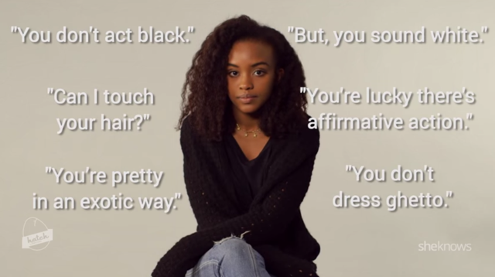
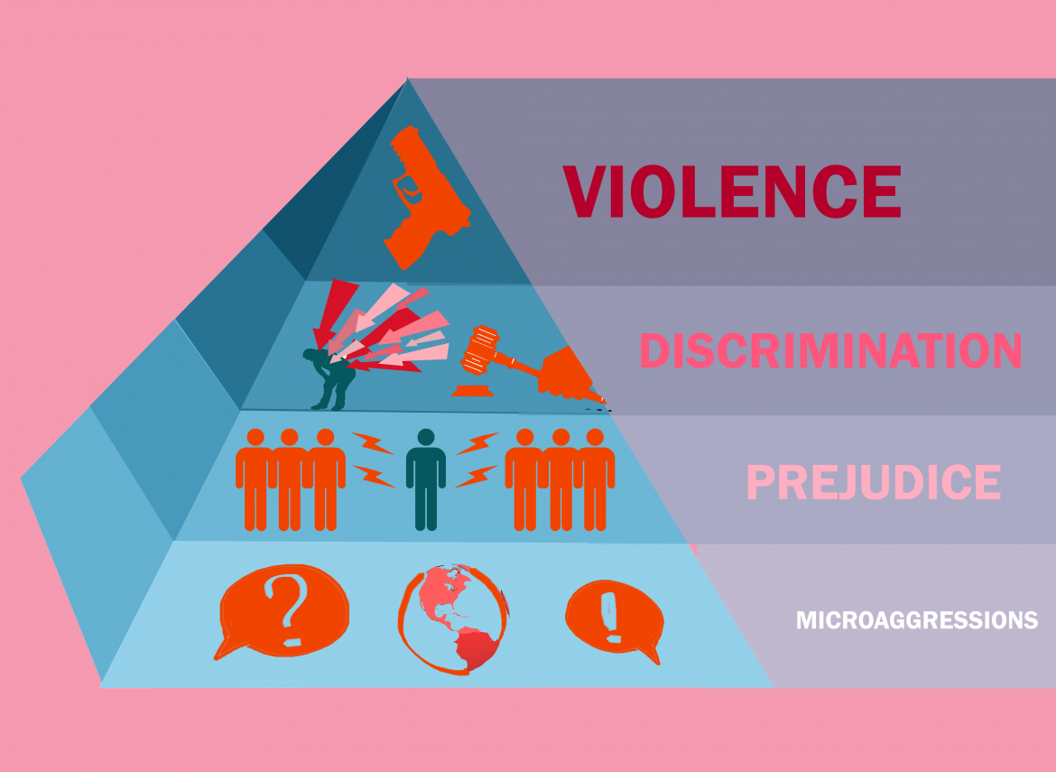
Microaggressions?
Microinsults | Microinvalidations | Microassaults
Unconscious Insensitive or ignorant | Unconscious Invalidations | Conscious Systematic
Source Images from https://aplus.com/a/hatch-workshop-teenagers-microaggressions-?no_monetization=true and http://theconcordian.com/2017/02/how-microaggressions-lead-to-mass-shootings/
Notes:
Microaggressions are either miniscule or overt behaviors, sayings, attitudes, etc. that communicate contempt, disrespect, or ignorance, towards a person based on identifying markers such as but not limited to race, ethnicity, gender, sexuality, ability, and age.

Slide 3
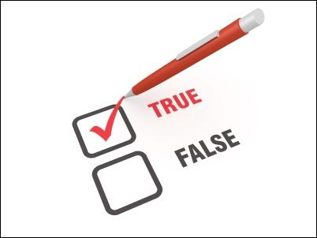
Literature Review
Debate on validity of microaggressions
Are they real?
Lack of information
Impacts
Self-esteem
Racial climate on a campus
Student performance
Source image from http://www.thepsychometrictest.com/reliability/

Slide 4
Limitations of current research
Quantitative data
Non-Black and non-Latinx identities
Examining multiple identifying markers
Classism, ageism, gender identity, sexuality, etc.
Intersectionality of identities

Slide 5
- Experiences
- Importance of one’s voice
- Lack of information
- Invalidation
Source Image from http://stpaulscb.org/2017/01/25/answering-the-why-questions/

Slide 6
Procedure
20 Black undergrad students
Interview
- One on one interview
In person survey
- Combination of microaggression scales
- Whether experienced, frequency of experiencing said microaggression, distress associated with experience,
- Scaled from 0-3, with 0 being rarely/never and 3 being frequently/often
Regression
- Tests for relationship between variables
- Scatter plot
5 per year

Slide 7
Going Forward
Create a prototype for an all-encompassing scale
Involves multiple identifying markers
Race/ethnicity, socioeconomic status, religion, age, ability
Source Image from https://careerconfidential.com/ultimate-guide-to-job-interview-prep/?utm_referrer=https%3A%2F%2Fwww.google.com%2F

Slide 8
I would like to extend a thank you to everyone involved with this program. Thank you Professor Vaughn, Professor Dominguez, Professor Hatch, Dean Finn, Mrs. Pingry, and Mr. Posner. Thank you all for you effort, time, and mentorship.
ACKNOWLEDGEMENTS

Slide 9
Works Cited/ Works Referenced
Crenshaw, Kimberle. “Demarginalizing the Intersection of Race and Sex: A Black Feminist Critique of Antidiscrimination Doctrine, Feminist Theory and Antiracist Politics.” The University of Chicago Legal Forum, vol. 140, 1989, pp. 139–167.
Du Bois, W.E.B. The Souls of Black Folk. http://avalon.law.yale.edu/20th_century/dubois_01.asp. Accessed 12 July 2018.
Houshmand, Sara, et al. “Racial Microaggressions: A Primer with Implications for Counseling Practice.” International Journal for the Advancement of Counselling, vol. 39, no. 3, Sept. 2017, pp. 203–16. link-springer-com.turing.library.northwestern.edu, doi:10.1007/s10447-017-9292-0.
Keels, Micere, et al. “The Psychological and Academic Costs of School-Based Racial and Ethnic Microaggressions.” American Educational Research Journal, vol. 54, no. 6, Dec. 2017, pp. 1316–44. Crossref, doi:10.3102/0002831217722120.
Lewis, Jioni A., et al. “Coping with Gendered Racial Microaggressions among Black Women College Students.” Journal of African American Studies, vol. 17, no. 1, Mar. 2013, pp. 51–73. link.springer.com, doi:10.1007/s12111-012-9219-0.
Lilly, Flavius R. W., et al. “The Influence of Racial Microaggressions and Social Rank on Risk for Depression Among Minority Graduate and Professional Students.” College Student Journal, vol. 52, no. 1, Spring 2018, pp. 86–104.
Stapleton, Lissa, and Natasha Croom. “Narratives of Black d/Deaf College Alum: Reflecting on Intersecting Microaggressions in College.” Journal of Student Affairs Research and Practice, vol. 54, no. 1, Jan. 2017, pp. 15–27. Routledge. Available from: Taylor & Francis, Ltd. 530 Walnut Street Suite 850, Philadelphia, PA 19106. Tel: 800-354-1420; Tel: 215-625-8900; Fax: 215-207-0050; Web site: http://www.tandf.co.uk/journals.
Sue, Derald Wing, et al. “Racial Microaggressions in Everyday Life: Implications for Clinical Practice.” American Psychologist, vol. 62, no. 4, 2007, pp. 271–86. Crossref, doi:10.1037/0003-066X.62.4.271.
Torres-Harding, Susan R., et al. “The Racial Microaggressions Scale (RMAS): A New Scale to Measure Experiences of Racial Microaggressions in People of Color.” Cultural Diversity and Ethnic Minority Psychology, vol. 18, no. 2, 2012, pp. 153–64. Crossref, doi:10.1037/a0027658. Nov. 2017, pp. 668–91. link-springer-com.turing.library.northwestern.edu, doi:10.1007/s11256-017-0414-0.

