Slide 1
Jekyll & Institutional Repositories
Chris Diaz, Digital Publishing Librarian
chris-diaz@northwestern.edu
@chrisdaaz
Notes:
I am the digital publishing librarian at Northwestern University in Evanston, Illinois. My responsibilities include managing an institutional repository and facilitating scholarly publishing projects, like journals and conference proceedings. I’m going to be talking about how I am using Jekyll with our institutional repository.

Slide 2
Jekyll is a static site generator
Open source software that transforms plain text into websites from the command line
No database queries, content management system (CMS), or server-side processing
Static websites are smaller, faster, more stable, and more secure than CMS-driven websites
Visit: https://jekyllrb.com
Notes:
Jekyll is a popular open source, static site generator. Static site generators are command-line tools that transform plain text files into websites.
One way of the main advantages of using a static site generator instead of a system like WordPress is that there are no databases or server-side processing required to run on servers for generating dynamic content to end-users. This makes static websites cheaper to host, easier to maintain, and safe from malware attacks.
Jekyll is only one of hundreds of static site generators, and they all basically perform the same tasks. Other popular tools include Hugo and Gatsby, and I’m definitely not alone in the digital library community creating static websites.

Slide 3
Plain Text Scholarship
Metadata → YAML
Full-text → Markdown
Template → HTML/ CSS
Notes:
The use case I will be focusing on is scholarly publishing, specifically journals and conference proceedings. This is a basic terminology mapping between scholarly publishing and Jekyll. Metadata is formatted as YAML, the full-text is formatted as Markdown, and the templates are created with HTML and CSS. If you have a basic familiarity with these markup languages, you’re well equipped to begin creating websites with Jekyll.

Slide 4
_articles/
article-1.md
article-2.md
_layouts/
default.html
article.html
_includes/
main-nav.html
index.html
css/
styles.css
config.yml
index.md
about.md
Notes:
A standard Jekyll project is basically a folder with several subdirectories that contain plain text files.

Slide 5
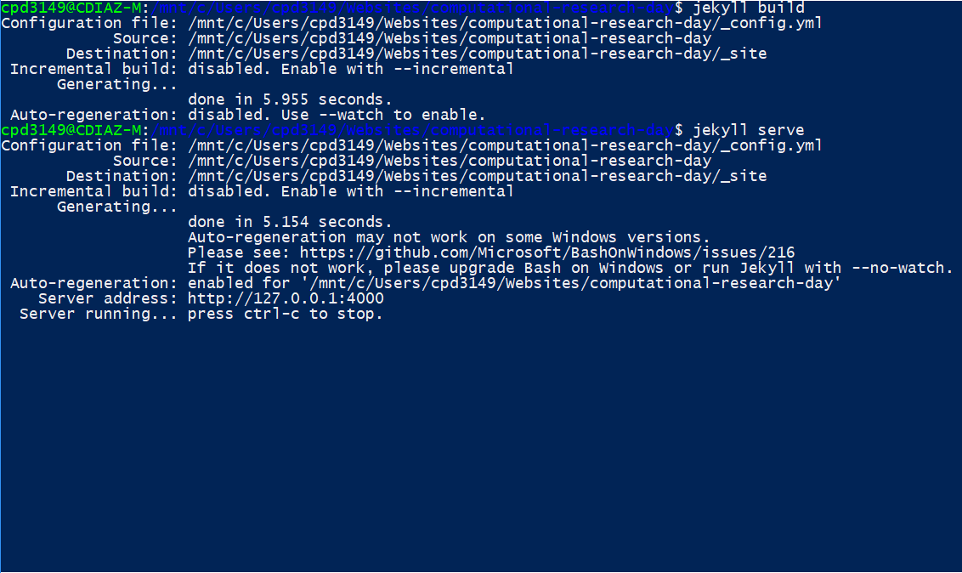
Notes:
When you run a Jekyll command, the software takes the content that you’re storing in YAML and Markdown and creates the website from the HTML templates and CSS styles you specified. The Jekyll community has released a lot open source themes that you can use if you don’t want to mess around too much with CSS.

Slide 6
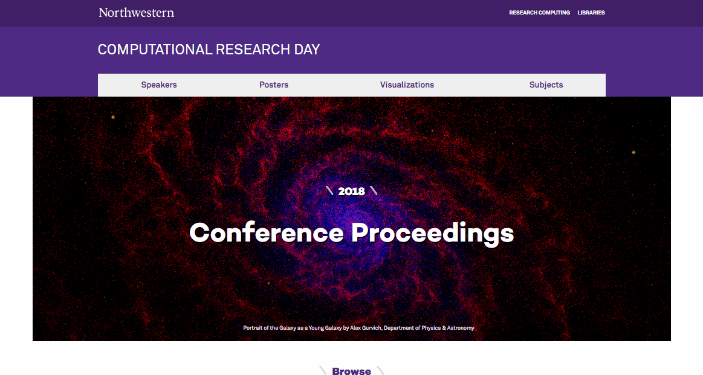
Visit: crd.northwestern.edu
Notes:
I recently used Jekyll to create a conference proceedings publication for Northwestern’s Computational Research Day. This publication collects posters and visualizations, including images, video. These non-traditional scholarly materials are exactly the types of things I look for when promoting our institutional repository.
I created this site because I wanted a light-weight solution for presenting the content that is ultimately stored in the repository. This is a much more appealing user interface than the standard collection view in our repository.

Slide 7
The DOI was generated by the repository and points to the repository copy
Notes:
Each item on the website has a landing page that displays the content, allows users to download the content, and provides a DOI for citation and persistent linking. The DOI is the primary connection point between the static website and the repository.

Slide 8
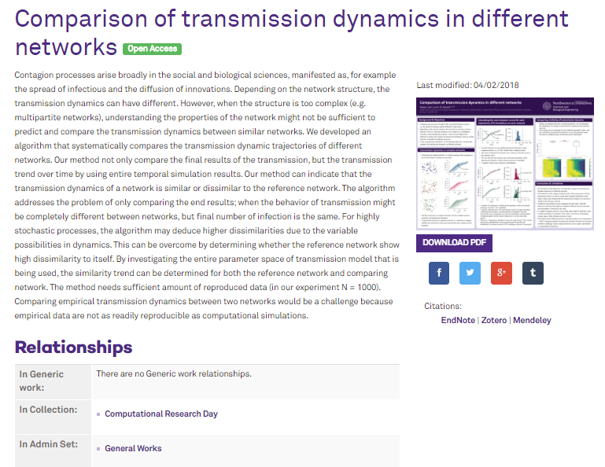
Notes:
The DOIs are generated by the repository and point to the repository copy of the item. Linking the two versions of the items is a manual process, but the authors can deposit their work in the repository, which means I’m basically using the repository as a submission tool.

Slide 9
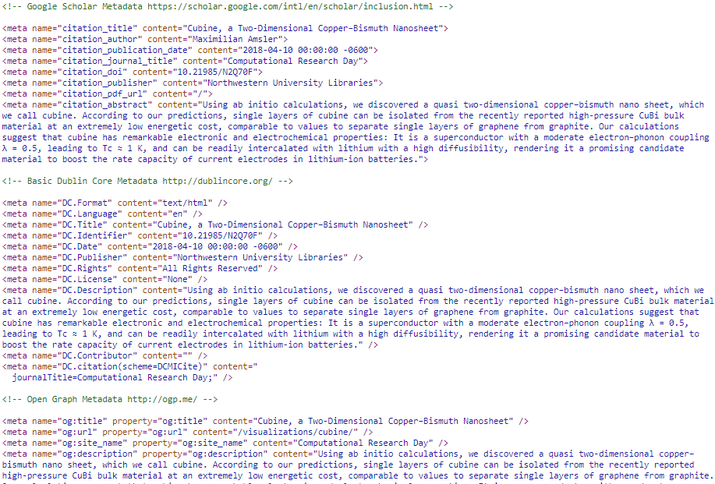
Notes:
Jekyll allows you to add more SEO to repository collections. Here’s some header text for Google Scholar, Dublin Core, and Open Graph metadata for an item on the static website.

Slide 10
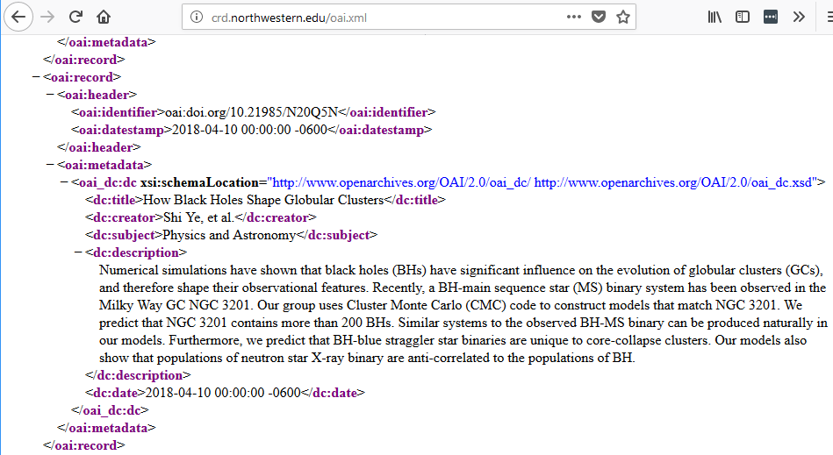
Notes:
You can use Jekyll to create OAI-PMH feeds for your scholarly publications, if you want.

Slide 11
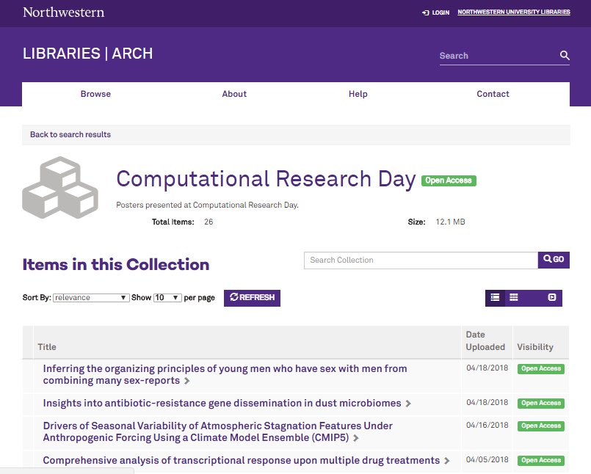
Notes:
One basic selling point for conferences, research centers, and academic departments is the ability to have collections in the repository. Every collection in our repository more or less looks the same: a landing page with a list of titles that link out to works. Often, people want more than this. They want a better, more customizable presentation for their research, and this is where Jekyll can be very useful.

Slide 12
Static Websites
Repository
Collection-level Presentation Layer
Institutional
Storage Layer

Slide 13
Characteristic | Static Websites | Institutional Repository
Lifespan | Short-term | Long-term
Metadata | Social Media Search Engine Optimization Google Scholar | Descriptive Technical Administrative
Content | Publication details Third-party content Full-text | Full-text
User Interface | Publication-level options | Repository-wide constraints
Performance | Client-side processing | Server-side processing
Required Technical Skills | HTML / CSS Markdown Terminal | Object-oriented Programming Web Application Frameworks HTML / CSS JavaScript Terminal

Slide 14
Static Website: crd.northwestern.edu Slides: http://bit.ly/jekyll-OR2018 Email: chris-diaz@northwestern.edu GitHub: github.com/chrisdaaz Twitter: @chrisdaaz

