Slide 1
Enacting Environmentally Sustainable Digital Preservation
[Event and date]
[Facilitator names and information]

Slide 2
Workshop Foundation
Keith L. Pendergrass, Walker Sampson, Tim Walsh, and Laura Alagna. “Toward Environmentally Sustainable Digital Preservation.” American Archivist 82, no. 1 (Spring/Summer 2019): 165-206.
Notes:
The foundation for this workshop is a recent article in the American Archivist. First, we will give a brief overview of our central argument to make sure that we all have a common understanding for the discussion sessions.

Slide 3
Environmental Impact of Digital Preservation
No quantitative research on the complete environmental impact of digital preservation practices
Digital preservation relies heavily on digital infrastructure
Explore impact using Information and Communication Technology (ICT) as a proxy
Notes:
While there was no quantitative research on the complete environmental impact of digital preservation practices at the time of the article, we can use the digital infrastructure that digital preservation relies upon (information and communication technology, or ICT) as a proxy for assessing digital preservation’s impact.

Slide 4
Environmental Impact of ICT
ICT components have significant environmental and human impacts throughout their complex life cycles
Extraction and refining of raw materials
Shipping and manufacture
Electricity and cooling
Disposal
Notes:
When we think about environmental impact, we need to look beyond the electricity required for use, and explore the full life cycle impacts of ICT components.

Slide 5
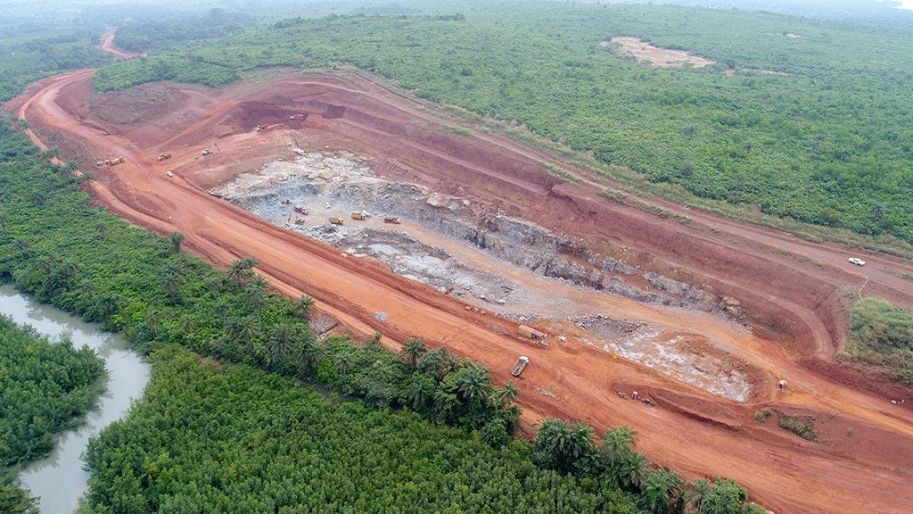
Environmental Impact of ICT
Resource Extraction
Photo: Bel Air open-pit mine in Guinea
Credit: International Mining, https://im-mining.com/site/wp-content/uploads/2017/12/November-Quarry-390x260.jpg
Notes:
First, we need to extract raw materials from the Earth.

Slide 6
Environmental Impact of ICT
Refining and industrial processes
Photo: Metal casting at Reliance Foundry in Canada
Credit: Reliance Foundry, https://www.reliance-foundry.com/castings
Notes:
Then we must refine the raw materials and use other industrial processes to make usable metals and plastics.

Slide 7
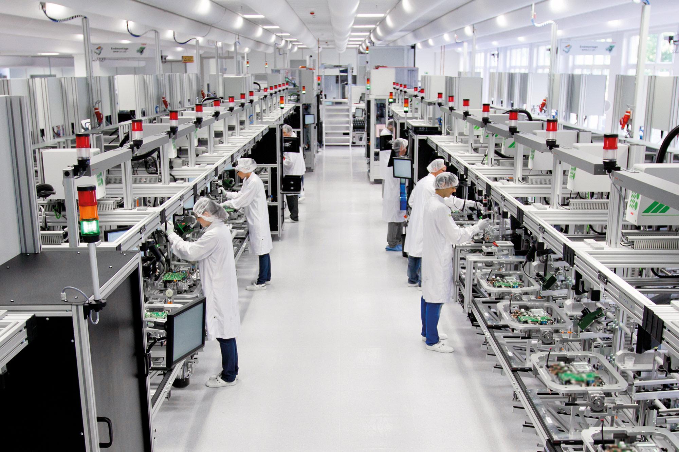
Environmental Impact of ICT
Manufacture and shipping
Photo: Container ship from the Yang Ming Marine Transport Corporation
Credit: Universal Cargo, https://www.universalcargo.com/wp-content/uploads/ container-ship-emissions.jpg
Photo: Electronic component manufacturing
Credit: Zollner Elektronik AG, https://www.zollner-electronics.com/fileadmin/user_upload/Header/header-produktion.jpg
Notes:
Then we need to manufacture all of the components, using processes that are increasingly high-tech and energy intensive. Once assembled, components are shipped around the world.

Slide 8
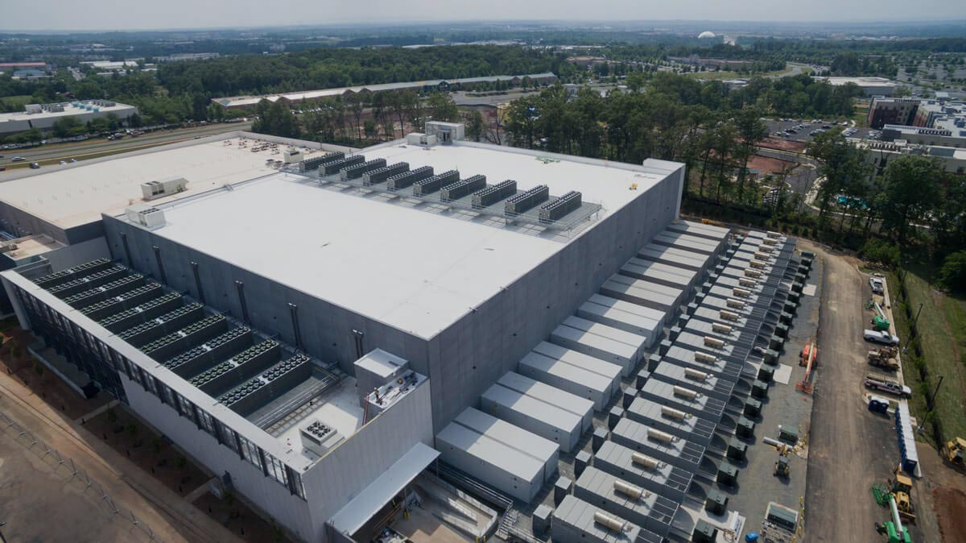
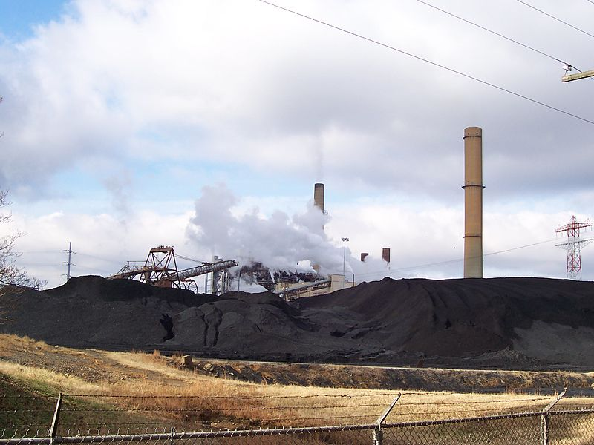
Environmental Impact of ICT
Electricity for use and cooling
Photo: CyrusOne’s Sterling, Virginia data center
Credit: CyrusOne, https://cyrusone.com/locations/virginia/data-center-sterling/
Photo: Coal ash at Chesterfield Power Station, Virginia
Credit: Wikimedia Commons, https://commons.wikimedia.org/wiki/File:Chesterfield_Power_Station.jpg
Notes:
Now we can put the components to use! The core functions of storage and computing power require large amounts of electricity to power and cool components. In 2018, 63% of US electricity generation was from fossil fuels (according to the US EIA), produced at plants such as at the 1,415 megawatt coal- and natural gas-fired Chesterfield Power Station in Chesterfield County, Virginia.

Slide 9
Environmental Impact of ICT
E-waste disposal
Photo: Burning e-waste to retrieve metals in Agbogbloshie, Ghana
Credit: Chicago Monitor, https://chicagomonitor.com/2016/10/e-waste-and-economic-viability-why-do-we-blame-developing-countries/
Notes:
At the end of their useful life, ICT components are often disposed of in undocumented ways. Much of this e-waste ends up in developing countries where people, including children, burn the components to melt the metals for salvage. Clearly, when we explore the full ICT component lifecycle, the impacts are much more severe than simply using fossil-fuel derived electricity.

Slide 10
Reducing the Impact of ICT
Increase energy efficiency
Schedule high-impact tasks for off-peak times
Use clean energy
Notes:
And while there are strategies to reduce the impact of our use of ICT components, such as increasing energy efficiency, scheduling tasks for off-peak times, and using clean electricity...

Slide 11
Digital Preservation Practitioners’ Response
Need to address impacts from the ICT component life cycle
Reactive solutions are insufficient in the face of the scale and growth of CHO’s digital preservation activities
Notes:
...these actions do not address the full life cycle impacts and are insufficient when we consider the scale and growth of CHO digital preservation activities.

Slide 12
Creating Sustainable Digital Preservation
Re-evaluate what is required for successful sustainable digital preservation
Explicitly integrate and balance management, successful use, and environmental sustainability
Notes:
To find solutions that are proportional to the negative impacts, we need to re-evaluate what is required for successful sustainable digital preservation by integrating and balancing management, successful use, and environmental sustainability.

Slide 13
Digital Preservation Paradigm Shift
Focus on high-value materials through a renewed emphasis on critical appraisal
Reduce the resource intensity of digital storage and management by rethinking digital permanence
Meet user needs in different ways by challenging assumptions about the availability of digital content
Notes:
The article proposed a three-part paradigm shift in which we:
Recommit to conducting critical appraisal, which allows us to focus our resources on high-value materials;
Rethink our goals around digital permanence to reduce the resource intensity of digital preservation actions; and
Challenge our assumptions about the availability of digital content to meet user needs in different ways.

Slide 14
Workshop Agenda
[Add the specific agenda for your workshop]
Notes:
So how do we enact that paradigm shift? That’s what we are going to work towards today.

Slide 15
Scoping
In Scope
All statements and questions related to the workshop’s foundational article, including critiques of the authors’ arguments
All statements and questions related to digital preservation and environmental sustainability
Out of Scope
Debates about climate science
The science is clear: the climate crisis is real and we are causing it

Slide 16
Discussion Norms
[Add any discussion norms for your workshop]

Slide 17
Discussion Session
[Add one or more slides based on your agenda with the details of the discussion sessions for your workshop]

Slide 18
Wrap-up
[Add any final details for your workshop]

