Slide 1
Examining the Health Consequences of the Nutrition Transition of Lowland Bolivia
Elias A. Caicedo and Dr. William Leonard
Notes:
move sun picture to background?

Slide 2
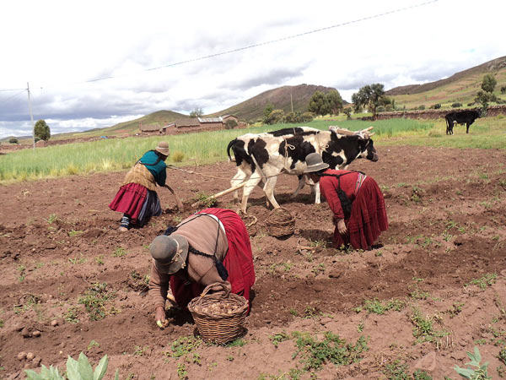
Background
Over the last 50 years, countries across the world have undergone a health transformation known as “Nutrition Transition”
Shift from subsistence to market-orientated lifestyle
Replacing plant-based/traditional diets with “Western Diet”

Slide 3
Background
Since 2002, the Tsimane Amazonian Study Panel (TAPS) has monitored lifestyle/health changes in the indigenous Tsimane population
13 villages outside the town of San Borja, Bolivia

Slide 4
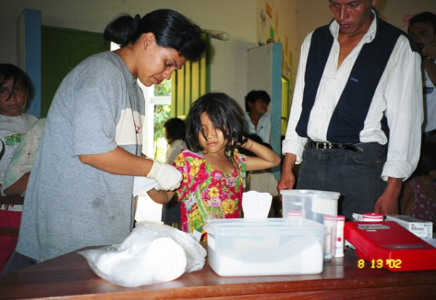
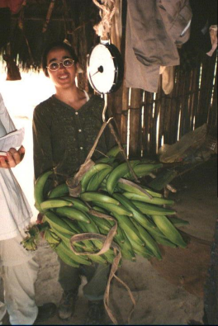
Methods
Data collected from 2002 to 2010 (WR Leonard et al., 2015)
n = 633 adults and 820 children

Slide 5
Experiment
Variable (Units)
Body Mass Index (kg/m^2)
Body Fat Percentage (%)
Waist Circumference
Growth Rate
Height-to-Age Ratio
Standard/Average/Healthy
18 to 25
M: 15% to 24% ; F: 21 % to 30 %
M: less than 40” ; F: less than 35”
~7 lbs/year ; ~3”/year

Slide 6
Changes in the Body Mass Index (BMI; kg/m²):
Bolivian Tsimane’ 2002-2010
**
**
Differences between 2002 & 2010 significant at: **P < 0.001; n = 148 men; 165 women

Slide 7
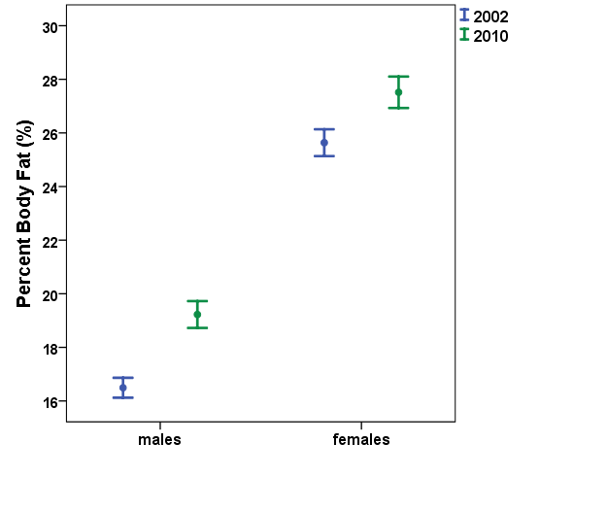
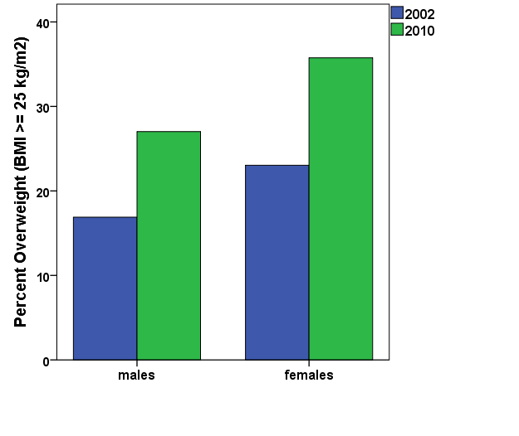
Changes in Body Fat Percentage and Prevalence of Overweight: Bolivian Tsimane’
a) Percent Body Fat (%)
b) Prevalence of Overweight
**
**
**
20% 🡪 32%
**
Differences between 2002 & 2010 significant at: **P < 0.001; n = 148 men; 165 women

Slide 8
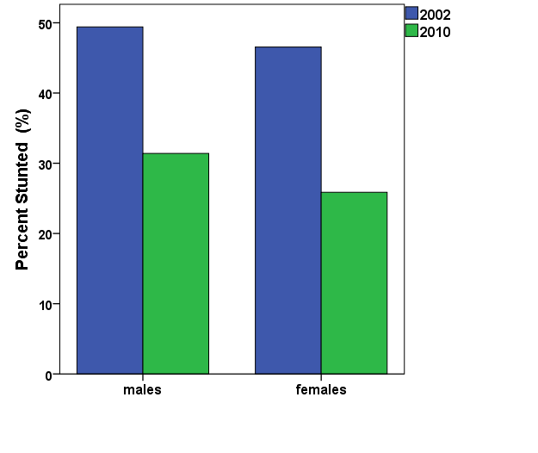
Declines in Growth Stunting among Tsmane’ Children: 2002-2010
**
**
48% 🡪 29%
Differences between 2002 & 2010 significant at: **P < 0.001; n = 172 boys; 174 girls

Slide 9
Changes in Height-for-Age Z-scores for Tsimane’ Children < 5 years in 2002
**
**
Differences between 2002 & 2010 significant at: **P < 0.001; n = 98 females; 97 males

Slide 10
Results of Nutrition Transition
Positives
increased food availability/accessibility
decreases in malnourishment
decreases in illness
increased growth rates
increased overall health of previously undernourished individuals
Potential Negatives
increased body fat percentage
increased prevalence of overweightness
increased risks for obesity, diabetes, and other health disorders

Slide 11
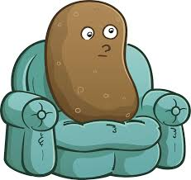
Conclusion
Evidence that processed foods and sedentary energy levels can lead to weight gain and various health complications
A balanced diet and moderate exercise is crucial for maintaining good health
Moderation is key

